Slide 1
CMR College of Engineering & Technology
(UGC Autonomous)
Accredited by NAAC with “A” Grade
Kandlakoya, Medchal Road, Hyderabad-501401
Department of CSE- (AI & ML)
Mini Project-II PRC-1
Blood group prediction using fingerprint map reading
BATCH NO. 25
Team Members:
Guided By:
20H51A6622 -T. Pranay Krishna
20H51A6647 -T. Justin Roy
20H51A6648 -T. Ajitha
Mr. Y. Mahendra Reddy
Asst.Prof
CMRCET – CSE (AI& ML)

Slide 2
Abstract
Blood group is detected by extracting the blood from human body and takes time to produce the result manually. Using fingerprint map reading, the blood group is predicted.
The fingerprint matching is processed with the estimation of ridge frequency.
CV & DIP concepts and datasets.

Slide 3
Introduction
The most reliable and unique feature of human identity is the fingerprint pattern.
Fingerprint based biometric identification is used for gender and age identification is also considerable modality of the application.
The Image Processing, which is the most penetrated device in both rich and resource-constrained areas, would be a suitable choice to build this solution

Slide 4
Existing system
Blood Group level measurement is a blood diagnosis process to determine the concentration of cell count in the blood. Clinicians measure Blood Group in several ways.
Invasive processes involve the addition of various chemicals to a blood sample and then optical variations are calculated using spectroscopic data to measure the Blood Group level.

Slide 5
Literature review
A rapid, precise, and robust human blood group identification method is introduced for the fast and accurate identification of blood group in the case of emergency blood.
https://www.ieeexpert.com/python-projects/blood-grouping-detection-using-image-processing-and-deep-learning/
https://www.researchgate.net/publication/359629771_A_Novel_Approach_for_ABO_Blood_Group_Prediction_using_Fingerprint_through_Optimized_Convolutional_Neural_Network

Slide 6
Proposed Method
A Non-invasive (without blood sample collection) approach involves data obtained from image sensors
Process involves output of a PPG sensor to calculate the Blood Group level.
An Image Processing-based POC tool as a potential alternative to invasive clinical blood testing is rapidly attracting attention because of the advantages of availability, user-friendliness, and easy attachability to different biosensing devices.
CNN based models have been developed to estimate the Blood Group levels from the selected features.

Slide 7
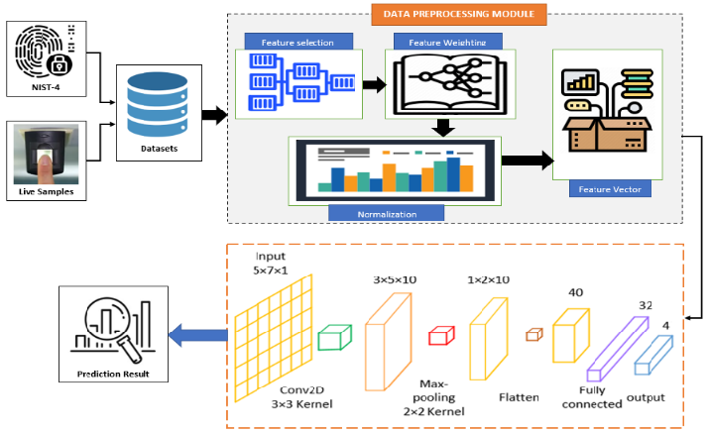
Proposed Block Diagram

Slide 8
Datasets & Logistics
Software Requirements:
Python
Computer vision Techniques
Front End – Anaconda IDE
Vs code
Dataset:
SOCOFing
FVC2000_DB4_B

Slide 9
Plan of progress
Digital images of hands
Training the model
Feature extraction
Prediction of output

Slide 10
Disadvantages for existing solution
Challenging Data Collection Methods
Complex Data Analysis And Feature Extraction Processes
 Lack Of Affordability And Portability
 Lack Of User-friendliness With Costly External Modules.

Slide 11
Thank you

Slide 12
This Project proposes a noninvasive Blood Group measurement processes. Also its compared the variation in data collection sites, biosignal processing techniques, theoretical foundations, photoplethysmogram (PPG) signal and features extraction process, Image Processing algorithms, and Detection models to calculate Blood Groups.
Although the invasive (blood sample collection) approach remains the most common.
This analysis was then used to recommend realistic approaches to build a Image Processing-based point-of-care tool for Blood Group measurement in a noninvasive manner.

